Slide 1
Data extract from LFP
LFP DATA BUBBLE DATA
6500911 = IMO 6.3979183 -57.4831717 = LAT & LONG J8MF = CALL SIGN 167 = HEADING ‘ 375133000 = MMSI 2012-11-15 23:59:51.543 AIS LAST SEEN DATE INGA B = NAME Cargo = TYPE 0.2 = CURRENT SPEED 10 = BEAM 2.6 = DRAUGHT 74 = LENGTH PARAMARIBO SURINAME Paramaribo = DESTINATION 27/10/2012 02:00:00 = DESTINATION ETA Anchored = MOVEMENT STATUS | INGA B = NAME 6500911 = IMO J8MF = CALL SIGN 375133000 = MMSI FLAG – SAINT VINCENT & GRENANDINES – OUR DATABASE -----***** 2.6 = DRAUGHT CARGO = SHIP TYPE CARGO = SHIP TYPE 74 = LENGTH 10 = BEAM 6.3979183 = LAT -57.4831717 = LONG 0.2 = CURRENT SPEED 167 = HEADING ‘ Anchored = MOVEMENT STATUS 2012-11-15 23:59:51.543 AIS LAST SEEN DATE USE THIS DATE INSTEAD OF UTC

Slide 2
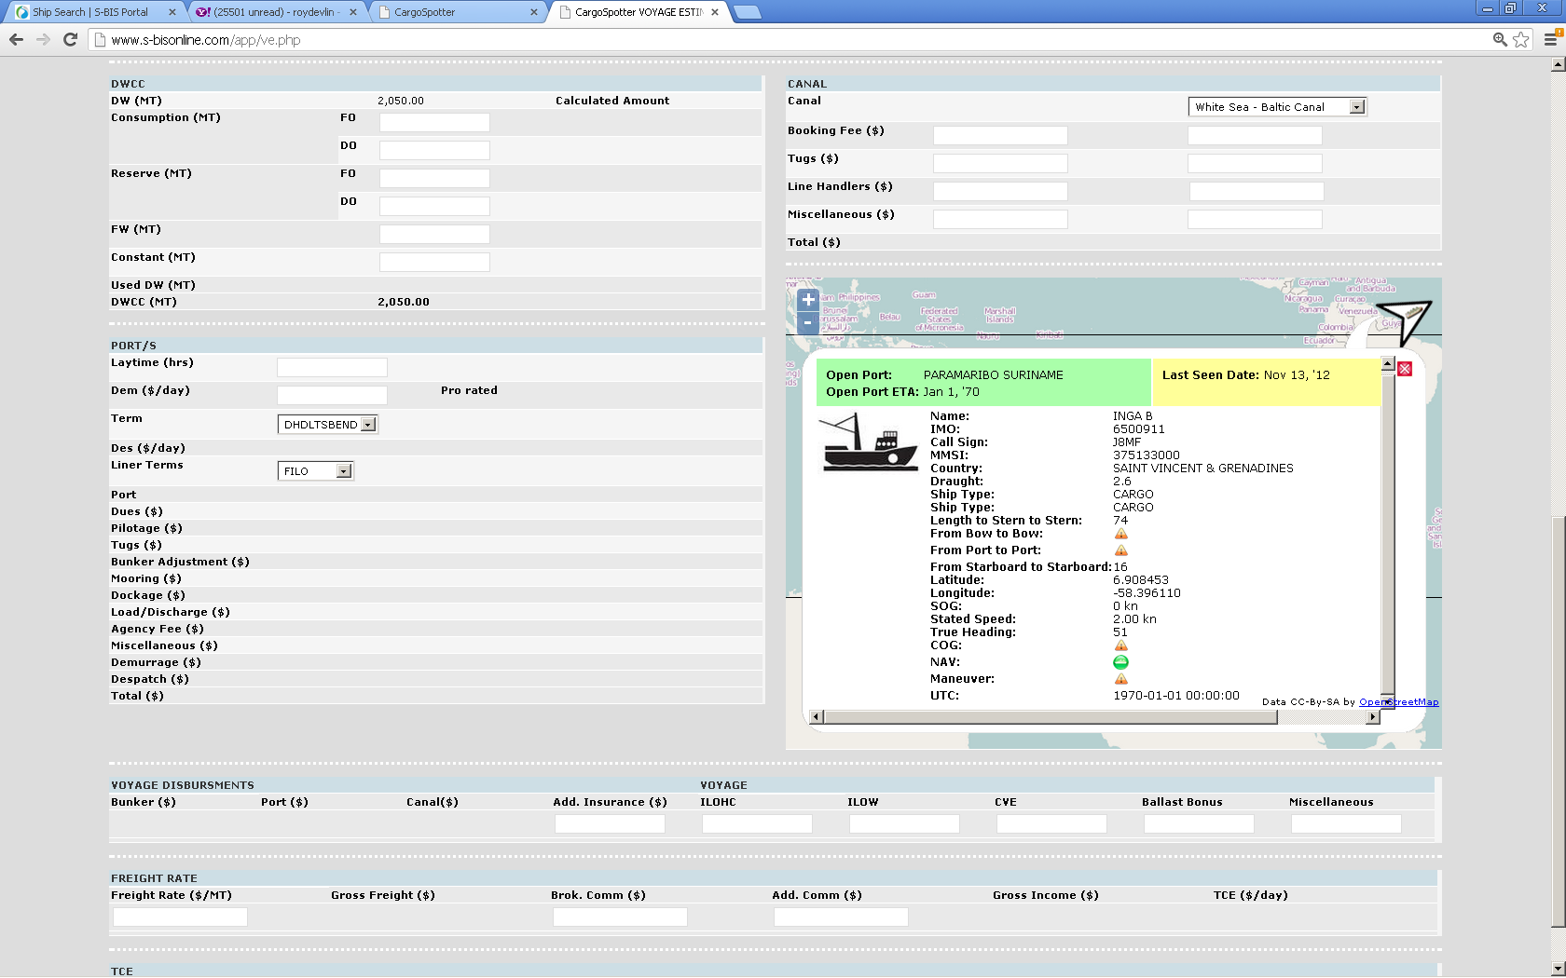
FROM AIS
DESTINATION : PARAMARIBO SURINAME ETA: Jan 1, 70 WRONG DATA – DATA GIVES ETA
DESTINATION : PARAMARIBO SURINAME ETA: 27/10/2012 02:00:00
AIS LAST SEEN DATE : 2012-11-15 23:59:51.543
INGA B = NAME
6500911 = IMO
J8MF = CALL SIGN
375133000 = MMSI
FLAG – SAINT VINCENT & GRENANDINES – OUR DATABASE -----***** 2.6 = DRAUGHT
CARGO = SHIP TYPE
CARGO = SHIP TYPE 74 = LENGTH
10 = BEAM
6.3979183 = LAT
-57.4831717 = LONG
0.2 = CURRENT SPEED
167 = HEADING ‘
Anchored = MOVEMENT STATUS
2012-11-15 23:59:51.543 AIS LAST SEEN DATE
USE THIS DATE INSTEAD OF UTC

